Slide 1
Cross Platform Application Development (Flutter)

Slide 2
History
Adobe Phonegap (Later known as Cordova PhoneGap)
Titanium
Ionic
Xamarin
React Native
Flutter

Slide 3
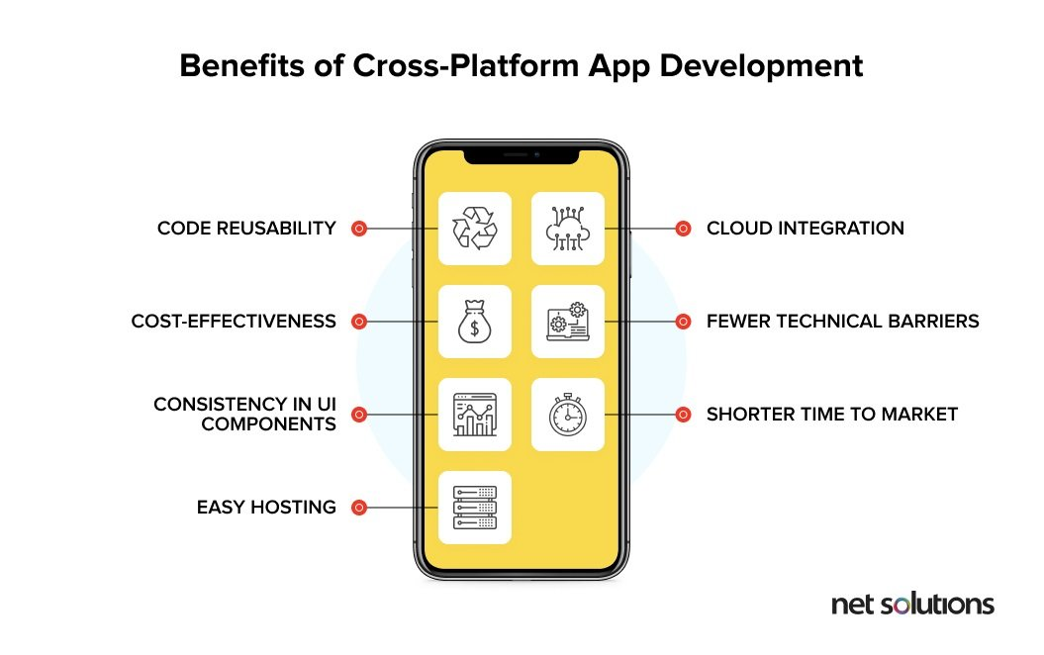
Why Cross Platform?
Notes:
1. Maximum Exposure to the Target Audience
Leveraging a mobile cross-platform development approach enables you to build an app and deploy over various platforms, including the web. This means that by building a single app, one can target both – iOS and Android platforms, thus, maximizing their reach.
2. Reduced Development Cost
The cross-platform app development is based on a concept ‘write once, run everywhere’. Reusable codes and agile app development through tools can lessen the cost of development. Therefore, in order to improve your business on multiple platforms and tools in a cost-effective way, there is no other alternative to cross-platform apps.
3. Easier Maintenance & Deployment
Since there’s only one developed app that runs over all platforms, it is easier to maintain as well as deploy code or changes made. Updates can promptly be synced over all platforms and devices, thus saving time and money. Moreover, if a bug is found in the common codebase, it should be fixed once. In this way, developers can save a lot on time and money.
4. Quicker Development Process
The quick development process is another win-win situation when it comes to developing cross-platform apps. Single source code for multiple platforms can help reduce the development efforts by 50 to 80%. It helps you to get a feature-rich business app in less time. The team of developers can meet the expected deadlines in cross-platform app development.
5. Reusable Code
Another good thing about this platform is that the code can be used again and again. Instead of developers developing new codes for every platform, a single code can be reused. This saves time as well as resources because it eliminates repetition in the task of creating codes.
6. Easy Integration with Cloud
Cross-platform mobile apps are totally compatible and can take advantage of various plugins integrated with the cloud settings. In other words, the single source code is coordinated with various plug-ins and extensions to enhance the app’s scalability and functionality.
7. Faster Time-to-Market and Customization
As we mentioned above ‘write once, run everywhere’ is the concept that is followed while building cross-platform app development. It allows app developers to reduce Time-to-Market (TTM) with a quick deployment.
Also, if you need to transform or customize the app, it’s easy for the developers to do minor changes in a single code. This, further, helps to deliver products more swiftly than the competitors by improving customer engagement.
8. Uniform Design
Users can recognize user interface (UI) elements, and foresee their interactions over various platforms. Therefore, User Experience (UX) is an important thing to consider for any app or software.
It’s hard to sync the various development projects while developing multiple apps. Cross-platform mobile development tools allow developers as well as designers to build an uniform user experience that app users can enjoy.

Slide 4
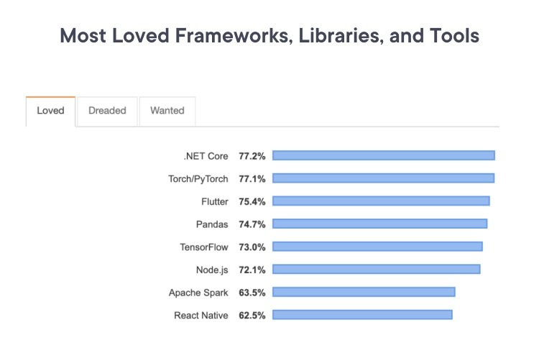
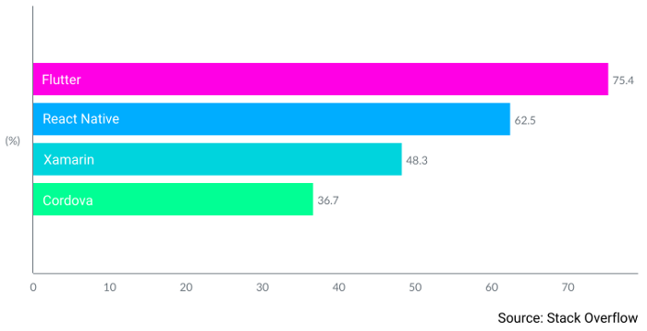
Which Platform to go for and why?
Notes:
Xamarin. Built with #C and .Net, Xamarin allows developers to create cross-platform applications for Android, iOS, tvOS, macOS, and Windows. Xamarin applications with shared interfaces are developed using Xamarin.Forms. If your goal is to design a platform-specific interface, Xamarin.iOS and Xamarin.Android are the go-to tools. Xamarin provides powerful libraries to access native and 3rd-party APIs, and leverage smartphone hardware and functionality: sensors, camera, text messages, connectivity, etc. Applications created with Xamarin perform on par with native apps — even when it comes to rendering dynamic data in real time.
React Native. Unveiled by Facebook in 2015, React Native has reigned in the cross-platform app development market ever since. The framework is based on React — a JavaScript library for building highly responsive user interfaces. With React Native, you can create mobile applications that share up to 80% of their codebase and can access certain native features like the accelerometer and smartphone camera, although you might need separate code for iOS and Android for that.
Apache Cordova. Apache Cordova’s tech stack features HTML5, CSS3, and JavaScript. The mobile app development framework provides access to a smartphone’s built-in accelerometer, file storage, GPS, contact data, media, and notifications. Apache Cordova boasts several advantages, including a fairly simple API and the opportunity to employ any JS framework. However, the platform visualizes app UIs through a web browser, which might cause lag. Also, some of Cordova’s plugins are dated, so developers often have to write custom ones from scratch.
Flutter. Flutter is Google’s UI toolkit that allows developers to create natively compiled applications for mobile devices, web browsers, and PCs using the same codebase. Flutter is based on Dart — a relatively new programming language that shares many features with Swift and Kotlin and can be transformed into JavaScript code. With Flutter, you can design applications that render fast and adapt to platform-specific UX logic. The framework is most suitable for MVP development.

Slide 5
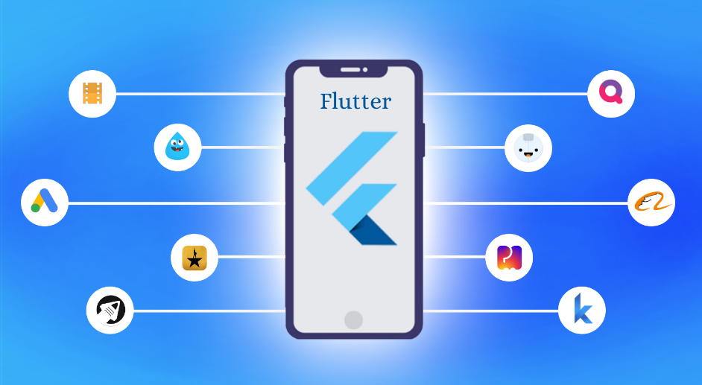
Flutter
Developed and released by Google in 2017.
Flutter is a popular open source and free cross-platform framework.
Uses Dart language to develop apps for Android, iOS, Mac, Windows, Linux and the Web
Famous Flutter Apps: Google, eBay
Alibaba and BMW

Slide 6
Step by Step - Installation Guide
Step 1 − Go to URL, https://flutter.dev/docs/get-started/install/windows and download the latest Flutter SDK.
Step 2 − Unzip the zip archive in a folder, say C:\flutter\
Step 3 − Update the system path to include flutter bin directory.
Step 4 − Flutter provides a tool, flutter doctor to check that all the requirement of flutter development is met.

Slide 7
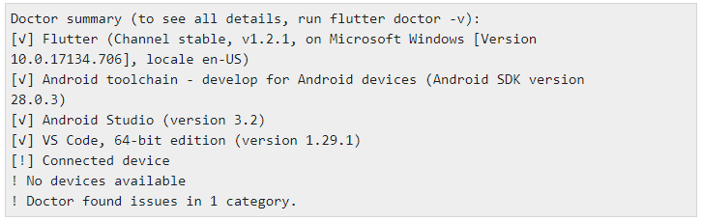
Step by Step - Installation Guide (Contd…)
Step 5 − Running the above command will analyze the system and show its report as shown below −
Note: The report says that all development tools are available but the device is not connected. We can fix this by connecting an android device through USB or starting an android emulator.

Slide 8
Step by Step - Installation Guide (Contd…)
Step 6 − Install the latest Android SDK, if reported by flutter doctor
Step 7 − Install the latest Android Studio, if reported by flutter doctor
Step 8 − Start an android emulator or connect a real android device to the system.
Step 9 − Download the plugins required by the tool you installed

Slide 9
VSCode – Tool Installation
Install VS Code, latest stable version.
Start VS Code.
Invoke View > Command Palette….
Type “install”, and select Extensions: Install Extensions.
Type “flutter” in the extensions search field, select Flutter in the list, and click Install. This also installs the required Dart plugin.

Slide 10
Creating first flutter application
Invoke View > Command Palette.
Type “flutter”, and select the Flutter: New Application Project.
Create or select the parent directory for the new project folder.
Enter a project name, such as myapp, and press Enter.
Wait for project creation to complete and the main.dart file to appear

Slide 11
Widgets
Widget is basically building block of every Flutter Application.
You guys can think of View for widget in Flutter.
Types of Widgets
Stateful Widget
Stateless Widget

Slide 12
Stateful or Stateless Widget
A stateless widget never changes. Icon, IconButton, and Text are examples of stateless widgets. Stateless widgets subclass StatelessWidget.
A stateful widget is dynamic: for example, it can change its appearance in response to events triggered by user interactions or when it receives data. Checkbox, Radio, Slider, InkWell, Form, and TextField are examples of stateful widgets. Stateful widgets subclass StatefulWidget.

Slide 13
Basic widgets
Flutter comes with a suite of powerful basic widgets, of which the following are commonly used:
Text
The Text widget lets you create a run of styled text within your application.
Row, Column
These flex widgets let you create flexible layouts in both the horizontal (Row) and vertical (Column) directions. The design of these objects is based on the web’s flexbox layout model.
Stack
Instead of being linearly oriented (either horizontally or vertically), a Stack widget lets you place widgets on top of each other in paint order. You can then use the Positioned widget on children of a Stack to position them relative to the top, right, bottom, or left edge of the stack. Stacks are based on the web’s absolute positioning layout model.
Container
The Container widget lets you create a rectangular visual element. A container can be decorated with a BoxDecoration, such as a background, a border, or a shadow. A Container can also have margins, padding, and constraints applied to its size. In addition, a Container can be transformed in three dimensional space using a matrix.
Notes:
Many Material Design widgets need to be inside of a MaterialApp to display properly, in order to inherit theme data. Therefore, run the application with a MaterialApp.
The MyAppBar widget creates a Container with a height of 56 device-independent pixels with an internal padding of 8 pixels, both on the left and the right. Inside the container, MyAppBar uses a Row layout to organize its children. The middle child, the title widget, is marked as Expanded, which means it expands to fill any remaining available space that hasn’t been consumed by the other children. You can have multiple Expanded children and determine the ratio in which they consume the available space using the flex argument to Expanded.
The MyScaffold widget organizes its children in a vertical column. At the top of the column it places an instance of MyAppBar, passing the app bar a Text widget to use as its title. Passing widgets as arguments to other widgets is a powerful technique that lets you create generic widgets that can be reused in a wide variety of ways. Finally, MyScaffold uses an Expanded to fill the remaining space with its body, which consists of a centered message.

Slide 14
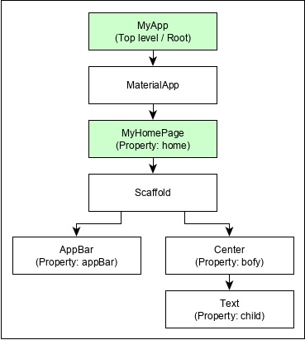
Flutter Application Hierarchy
Notes:
MyApp is the user created widget and it is build using the Flutter native widget, MaterialApp.
MaterialApp has a home property to specify the user interface of the home page, which is again a user created widget, MyHomePage.
MyHomePage is build using another flutter native widget, Scaffold
Scaffold has two properties – body and appBar
body is used to specify its main user interface and appBar is used to specify its header user interface
Header UI is build using flutter native widget, AppBar and Body UI is build using Center widget.
The Center widget has a property, Child, which refers the actual content and it is build using Text widget

